Slide 1



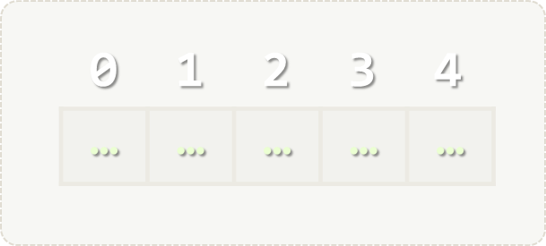
Lists
Processing Variable-Length Sequences of Elements
Lists
SoftUni Team
Technical Trainers
Software University
http://softuni.bg

Slide 2


Table of Contents
Operations with Lists
Reading Lists
Printing Lists

Slide 3
Questions?
sli.do #PythonFundamentals

Slide 4
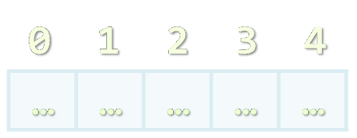
Lists

Slide 5
List
Provides the following operations:
[el1, el2, …] – creates list with the given items
len(list) – returns number of items in the List
list1 + list2 – concatenates the given lists
list * number – replicates the list number times
element in list – determines whether an item is in the list
for element is list: – iterates trough the lists items

Slide 6
List
Provides the following operations:
list[index] – returns the item in the given index
Indexes: 0 1 2 3 4
Indexes: -5 -4 -3 -2 -1
List: [1, 2, 3, 4, 5]
list[start:end] – returns the list of items between the given indexes
max(list)– returns the item with the max value from the list
min(list)– returns the item with the min value from the list

Slide 7
List
Provides the following operations:
list.append(item) – adds the item in the end of the list
list.count(item) – returns the number of occurences of item
list.index(item)– returns lowest positive index where the item is found
list.insert(index, item)– inserts the item at the index
list.pop(item = list[-1]) – removes and returns the last occurrence of item
list.remove(item) – removes the first occurance of item

Slide 8
List
Provides the following operations:
list.reverse() – reverses the list
list.sort() – sorts the list in increasing order
list.sort(reverse=True) – sorts the list in decreasing order

Slide 9

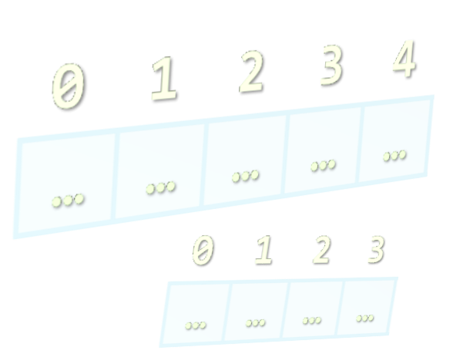
Reading Lists from the Console

Slide 10
Reading Lists From the Console
First, read from the console the length:
Next, create a list n and read its elements:
n = int(input())
list = []
for i in range(n):
list.append(int(input()))
# list += [int(input())]

Slide 11
Reading List Values from a Single Line
Lists can be read from a single line of space separated values:
string.split(' ') splits string by space and produces a list
2 8 30 25 40 72 -2 44 56
values = input()
items = values.split(' ')
nums = []
for i in items:
nums += [int(i)] # or nums.append(int(i))
Do everything at once
nums = [int(item) for item in input().split(' ')]

Slide 12
Printing Lists on the Console
Printing a list using a for-loop:
Printing a list using a string.join(…):
list = ["one", "two", "three", "four", "five", "six“]
for i in list:
print(i)
list = ["one", "two", "three", "four", "five", "six“]
print("; ".join(list))

Slide 13







Lists
https://softuni.bg/courses/programming-fundamentals

Slide 14
License
This course (slides, examples, demos, videos, homework, etc.) is licensed under the "Creative Commons Attribution-NonCommercial-ShareAlike 4.0 International" license
Attribution: this work may contain portions from
"Fundamentals of Computer Programming with C#" book by Svetlin Nakov & Co. under CC-BY-SA license

Slide 15





Trainings @ Software University
Software University Foundation – softuni.org
Software University – High-Quality Education, Profession and Job for Software Developers
softuni.bg
Software University @ Facebook
facebook.com/SoftwareUniversity
Software University Forums – forum.softuni.bg

